Slide 1
Lesson 17 – REST API

Slide 2

Contents
Why is it needed
Principles
How to use

Slide 3
Why is it needed
Flexibility
Scalability
Maintainability
…

Slide 4

REST
It’s all about communication between machines
(and RESTafarians)

Slide 5
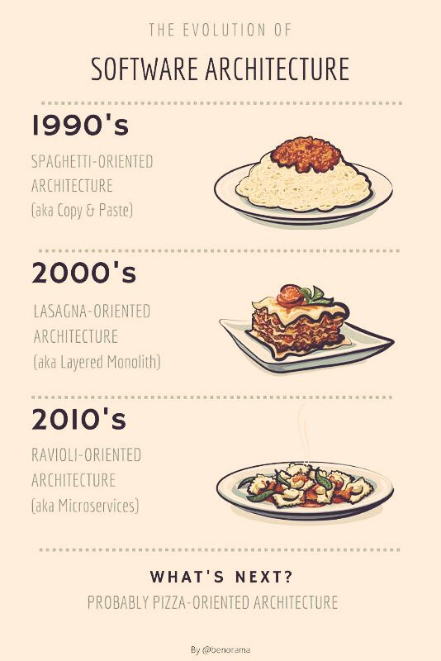
Evolution

Slide 6
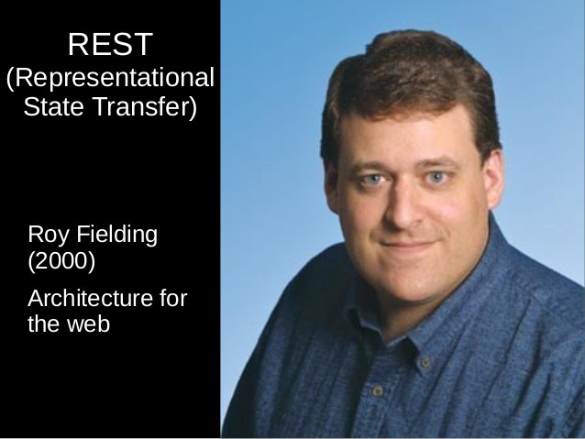
Principles
Resource
Representation
State
Transfer

Slide 7
Resource
Any information that can be named:
image
animal
user
…

Slide 8
Resource example
public class StudentDto {
@Nonnull private LocalDateTime examDate;
@Nonnull private Grade grade;
@Nullable private String name;
@Nullable private String surname; // getters, setters }

Slide 9
Constraints
Client-Server
Stateless
Cacheable
Uniform Interface
Layered system
Code on Demand

Slide 10
Operations
GET (fetch)
PUT (add, replace)
POST (add, change, delete)
DELETE (remove)
PATCH (change)
HEAD (get meta info)
OPTIONS (allowed operations/requirements)
TRACE (diagnostic)

Slide 11
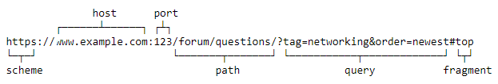
URI
Requirements:
Plural form (/users, /users/1, /users/1/contacts)
Action is described by http method but not URL or parameters
Dash as delimiter

Slide 12
Example
@RestController public class UserController { @GetMapping("/users/me") public List<UserDto> get(Authentication authentication) { return userManager.get(authentication.getUserId()); } @DeleteMapping("/users/me") public void delete(Authentication authentication) { userManager.delete(authentication.getUserId()); }
}

Slide 13
HATEOAS - hypermedia as the engine of application state
{ "user": { "id": 1, “name": "Yaroslav Brahinets", "email": "y.brahinets@gmail.com" }, "_links": { "users": { "href": "http://localhost:8090/users" }, “deactivate": { "href": "http://localhost:8090/users/1/deactivate" }, "self": { "href": "http://localhost:8090/users/1" } } }

Slide 14
Security
@Override protected void configure(HttpSecurity http) throws Exception { http.httpBasic().and() .authorizeRequests() .antMatchers(HttpMethod.GET, "/history/**").hasRole("USER") .antMatchers(HttpMethod.DELETE, "/history/**").hasRole("ADMIN") .antMatchers("/analytics/**").hasRole("ADMIN") .antMatchers("/coding/**").hasRole("GUEST")
…
}

Slide 15
Error handling
@ControllerAdvice public class ExceptionAdvice extends ResponseEntityExceptionHandler {
@ExceptionHandler(EmptyHistoryException.class) @ResponseStatus(HttpStatus.BAD_REQUEST) public ErrorDto handleEmptyHistoryException() { return new ErrorDto("History is empty"); } @ExceptionHandler(CodecUnsupportedException.class) @ResponseStatus(HttpStatus.BAD_REQUEST) public ErrorDto handleCodecUnsupportedException(
CodecUnsupportedException e
) { return new ErrorDto("Codec is not supported: " + e.getCodec()); } }

Slide 16
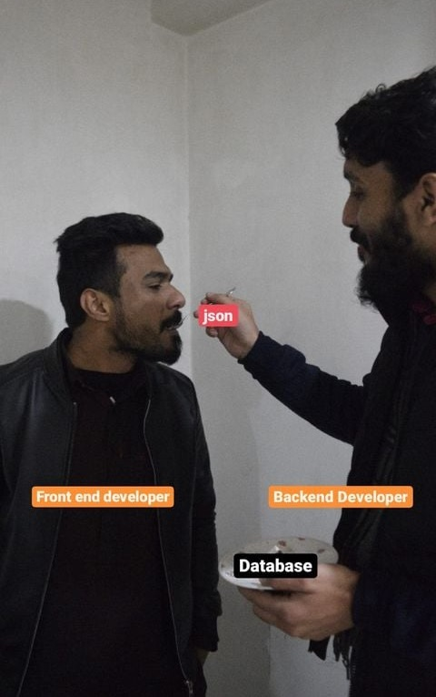
Result

Slide 17
HTTP Codes
2xx - Informational | 3xx - Redirect | 4xx - Client Error | 5xx - Server Error
200: OK | 301: Moved Permanently | 400: Bad Request | 500: Internal Server Error
201: Created | 302: Found | 401: Unauthorized | 501: Not Implemented
202: Accepted | 307: Temporary Redirect | 403: Forbidden | 502: Bad Gateway
204: No Content |  | 404: Not Found | 503: Service Unavailable
… | … | … | …

Slide 18
Versioning
Versioning through URI Path curl http://www.example.com/api/v1/products
Versioning through query parameters curl http://www.example.com/api/products?version=v2
Versioning through custom headers curl -H “Accepts-version: 1.0” http://www.example.com/api/products
Versioning through content negotiation curl -H “Accept: application/vnd.xm.device+json; version=1” http://www.example.com/api/products

Slide 19
Metadata transfer
Request
Accept:text/html,application/xhtml+xml,application/xml;q=0.9,image/webp,image/apng,*/*;q=0.8,application/signed-exchange;v=b3;q=0.9
Accept-Encoding: gzip, deflate, br
Accept-Language: en-US,en;q=0.9
Cookie: session_id=d5ebb75d36f8976d41131a44f7e99b82;…
Host: gitlab.com
Authoization: secure-token
Referer: https://gitlab.com/
User-Agent: Mozilla/5.0 (Windows NT 10.0; Win64; x64) AppleWebKit/537.36 (KHTML, like Gecko) Chrome/79.0.3945.130 Safari/537.36 OPR/66.0.3515.72
Response
Last-Modified: Sat, 09 Feb 2020 21:20:59 GMT
Content-Language: en
Content-Type: text/html; charset=utf-8
Content-Length: 1234

Slide 20
Auto Testing: Rest-assured
@Mock private UserRepository userRepository; private MockMvc mockMvc; @BeforeMethod public void init() { mockMvc = MockMvcBuilders .standaloneSetup(new UserController(userRepository)) .build(); } @Test public void shouldReturnCurrentUserInfo() throws Exception { UserDto user = new UserDto(1, "Yaroslav Brahinets" ,"y.brahinets@gmail.com"); when(userRepository.findById(1)).thenReturn(user); ResultActions perform = mockMvc.perform(get("/users/me").principal(user(1))); perform .andExpect(content().contentType(MediaType.APPLICATION_JSON_UTF8)) .andExpect(status().isOk()) .andExpect(jsonPath("$.id", is(1))) .andExpect(jsonPath("$.name", is(“Yaroslav Brahinets"))) .andExpect(jsonPath("$.email", is("y.brahinets@gmail.com"))); }

Slide 21

Manual Testing
Swagger - set of open-source tools built around the OpenAPI:
Swagger UI – renders OpenAPI specs as interactive API documentation.
Swagger Editor – browser-based editor where you can write OpenAPI specs.
Swagger Codegen – generates server stubs and client libraries from an OpenAPI spec.

Slide 22
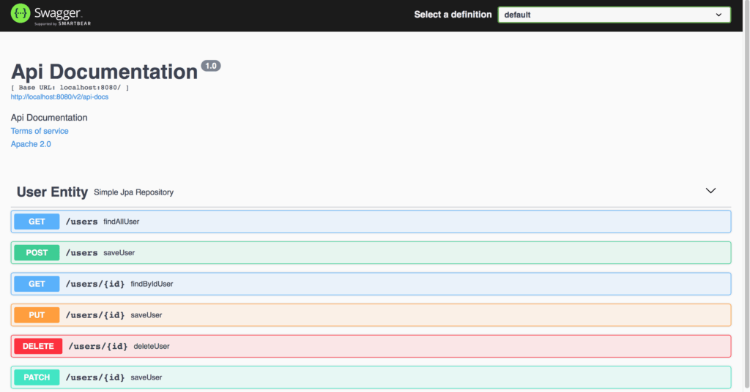
Swagger

Slide 23
Open API a.k.a. Swagger Speciﬁcation
API description specification for REST APIs in JSON/YAML format:
• Available endpoints (/users) and operations on each endpoint (GET /users, POST /users)
• Operation parameters Input and Output for each operation User
• Authentication methods
• Contact information, license, terms of use and other information

Slide 24


Alternatives
by Google (RPC on steroids)
by Facebook

Slide 25
Homework
Implement REST API (preserve existing Web UI and Console UI as well). Expose ability to use all existing features (get/add students, remove, analytics) but operate on a raw JSON via Swagger UI. Use appropriate HTTP methods and HTTP status codes;
Use ControllerAdvice and ExceptionHandler for mapping exceptions to the descriptive response objects with appropriate HTTP status codes;
Apply REST in course work.

Slide 26
Useful links
Spring REST
Testing Spring MVC REST
REST API design best practices
restapitutorial.com
Original REST dissertation by Roy Thomas Fielding

Slide 27
Thanks!
Any Questions?
Or find us in Slack:
@Yaroslav Brahinets
@Vasya Rudas

